Slide 1
Clinical Case “A”
Dave Bridges
dbridge9@uthsc.edu

Slide 2
Presentation
A 23-year-old woman visits her family physician with complaints
of a 12-month history of increasing nervousness, irritability, and
palpitations (a noticeable increase in the force of her heartbeat).
Furthermore, she feels very warm in a room when everyone else
feels comfortable. Her skin is unusually warm and moist to the
touch. She has lost 30 pounds of body weight over this period
despite having a voracious appetite and increased food intake.

Slide 3
More Presentation
Two years ago, she was jogging about 20 miles per week. However,
she had not done any running for the past year because she
“didn’t feel up to it” and complained of general muscle weakness.
She said she often felt irritable and had mood swings. Her menstrual
periods have been less frequent over the past year. Her previous
medical history was normal for a person her age. She states
that she has double vision when looking to the side but does not
have any loss of vision when using only one eye or the other.

Slide 4
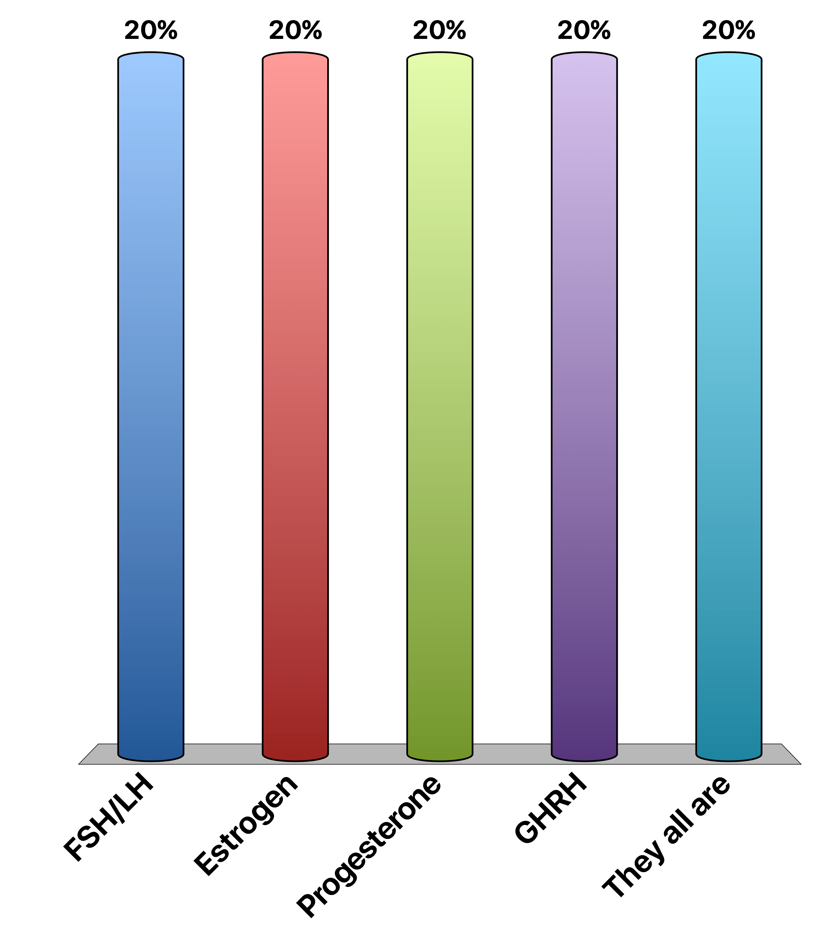
Which hormone(s) is/are released from the anterior pituitary
FSH/LH
Estrogen
Progesterone
GHRH
They all are
30

Slide 5
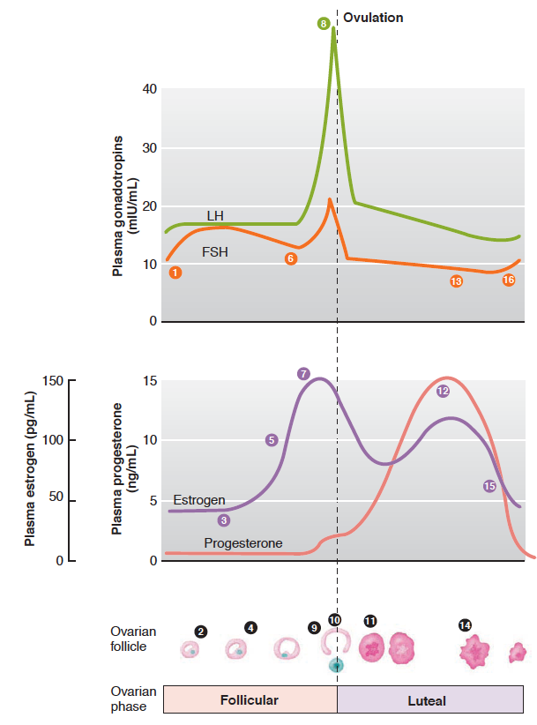
Menstrual Cycle Control

Slide 6
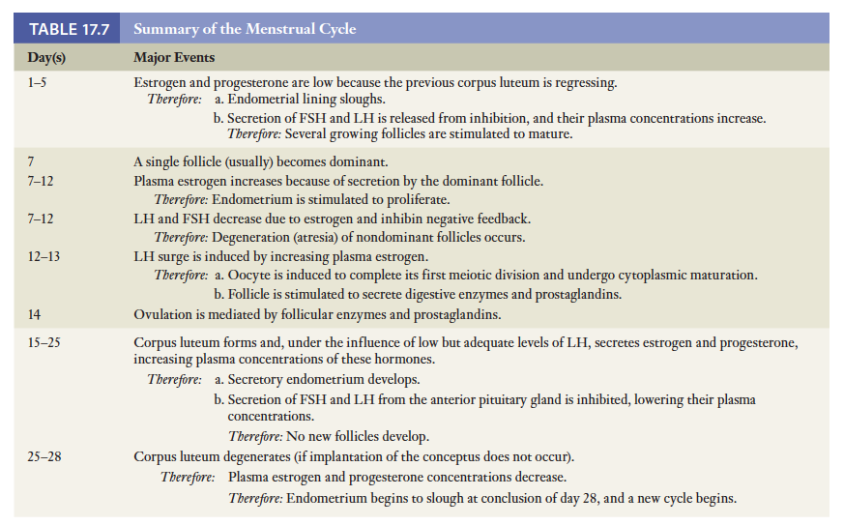
Menstrual Cycle Control

Slide 7
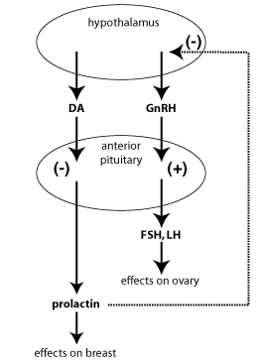
Prolactin Feedback
Dopamine
Inhibits
TRH Stimulates
Prolactin
Release

Slide 8
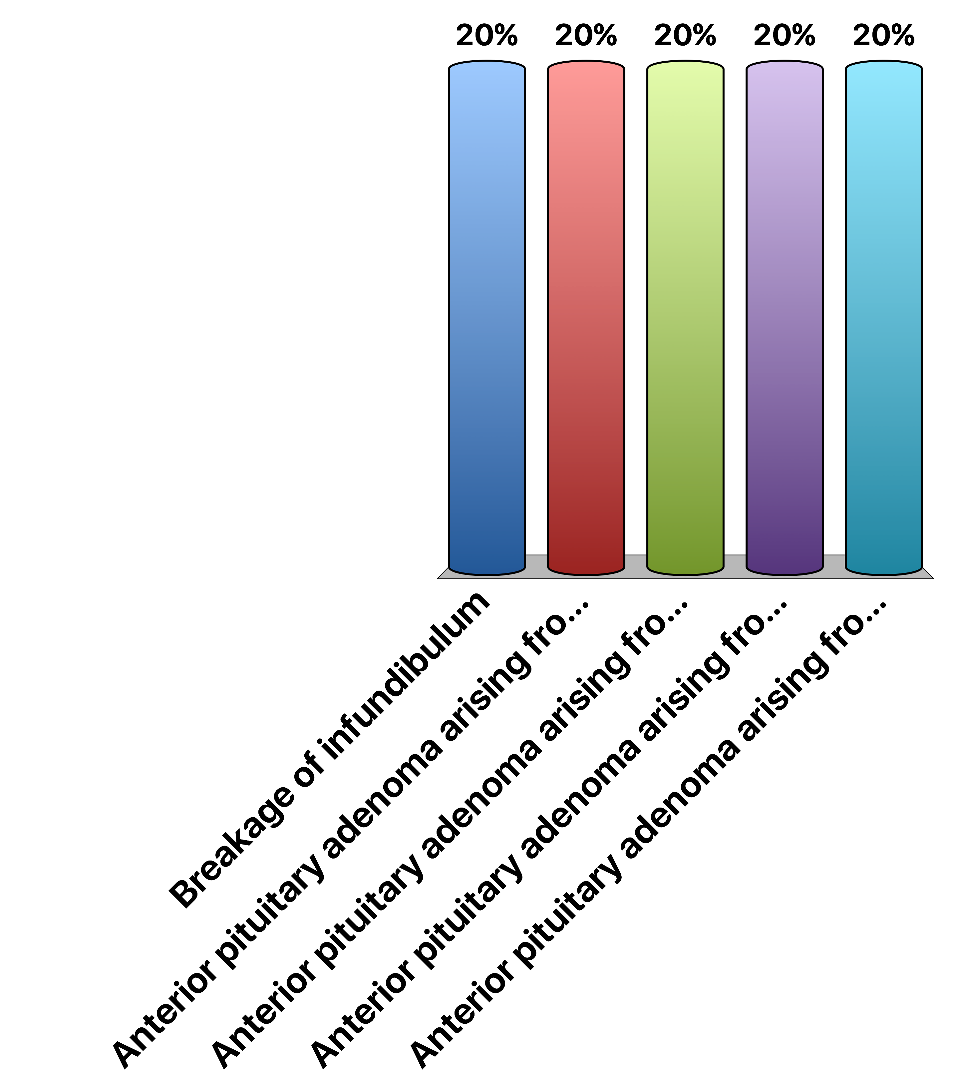
Which disorder could reduce menstrual cycle frequency AND loss of vision?
Breakage of infundibulum
Anterior pituitary adenoma arising from somatotropes
Anterior pituitary adenoma arising from thyrotropes
Anterior pituitary adenoma arising from gonadotropes
Anterior pituitary adenoma arising from lactotropes

Slide 9
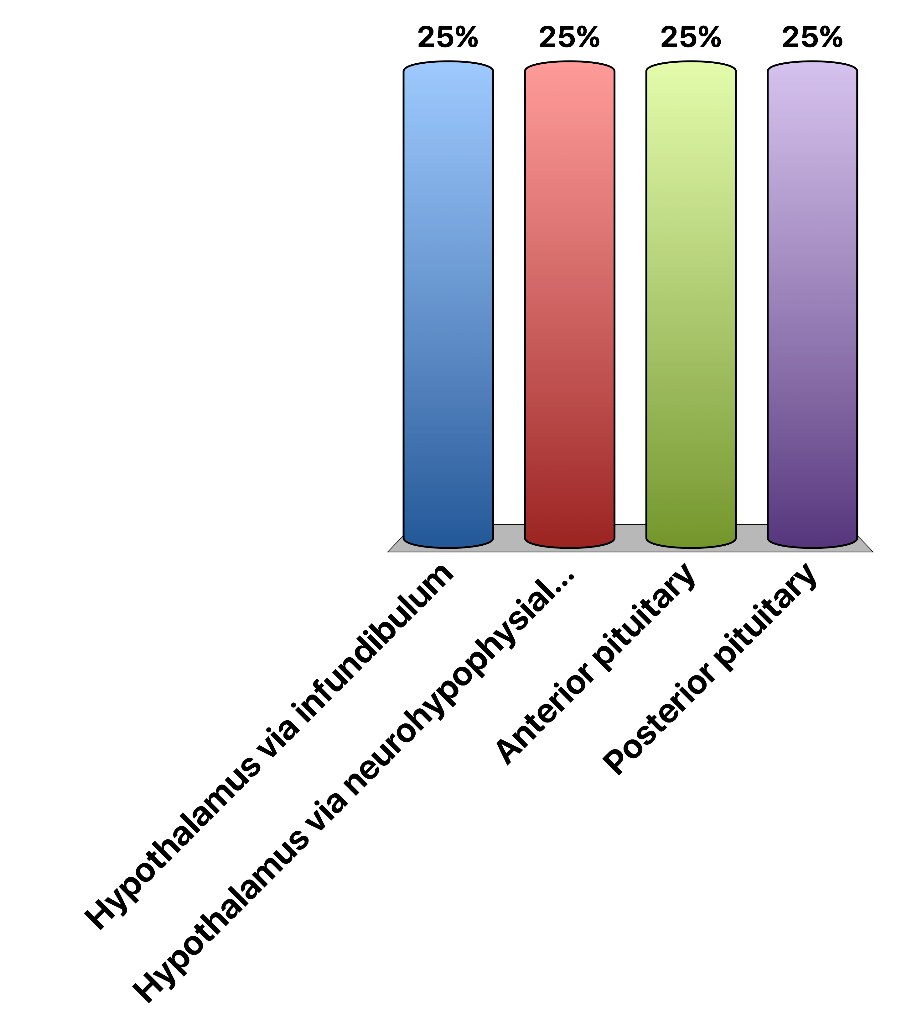
Where are TRH and DA coming from
Hypothalamus via infundibulum
Hypothalamus via neurohypophysial portal system
Anterior pituitary
Posterior pituitary
30

Slide 10
Vision Problems

Slide 11
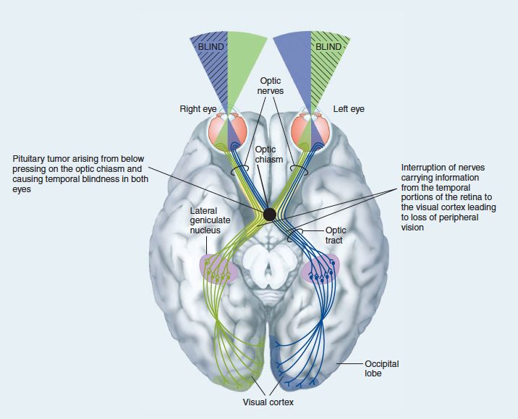
Putuitary Tumors

Slide 12
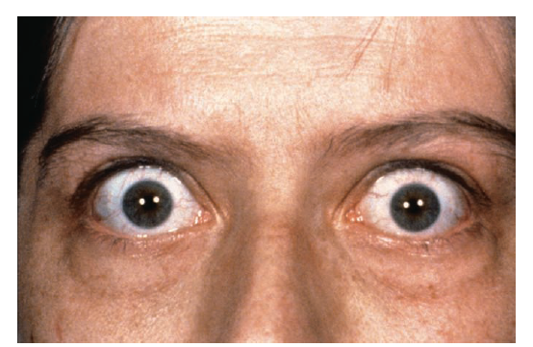
Physical examination
The patient is a 5 ' 7" (170 cm), 110-pound (50 kg) woman. Her systolic/
diastolic blood pressure is 140/60 mmHg (normal for a young,
healthy woman is about 110/70 mmHg). Her resting pulse rate is 100 beats per minute. Before she became ill, her resting heart rate
was about 60–70 beats per minute. Her respiratory rate is 17 breaths
per minute (normal for her was approximately 12–14 breaths per
minute). Her skin is warm and moist. Her eyes are bulging out
( proptosis or exophthalmos ). Finally, when she is
asked to gaze to the far right, her right eye does not move as far as
does her left eye and she says she has double vision ( diplopia ).

Slide 13
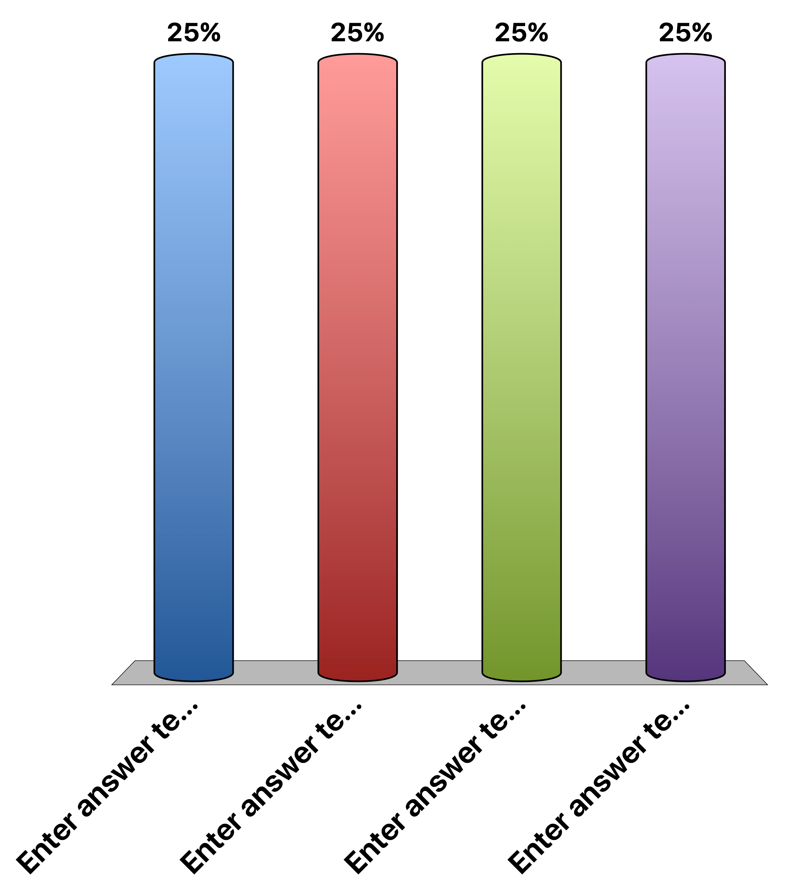
If the problem was a tumor causing over-active thyrotropes what hormones should be elevated?
TRH
TSH
T3/T4
All of the above
Response Counter
15

Slide 14
Tachycardia

Slide 15
Question
What could be causing her tachycardia and tachypnea

Slide 16
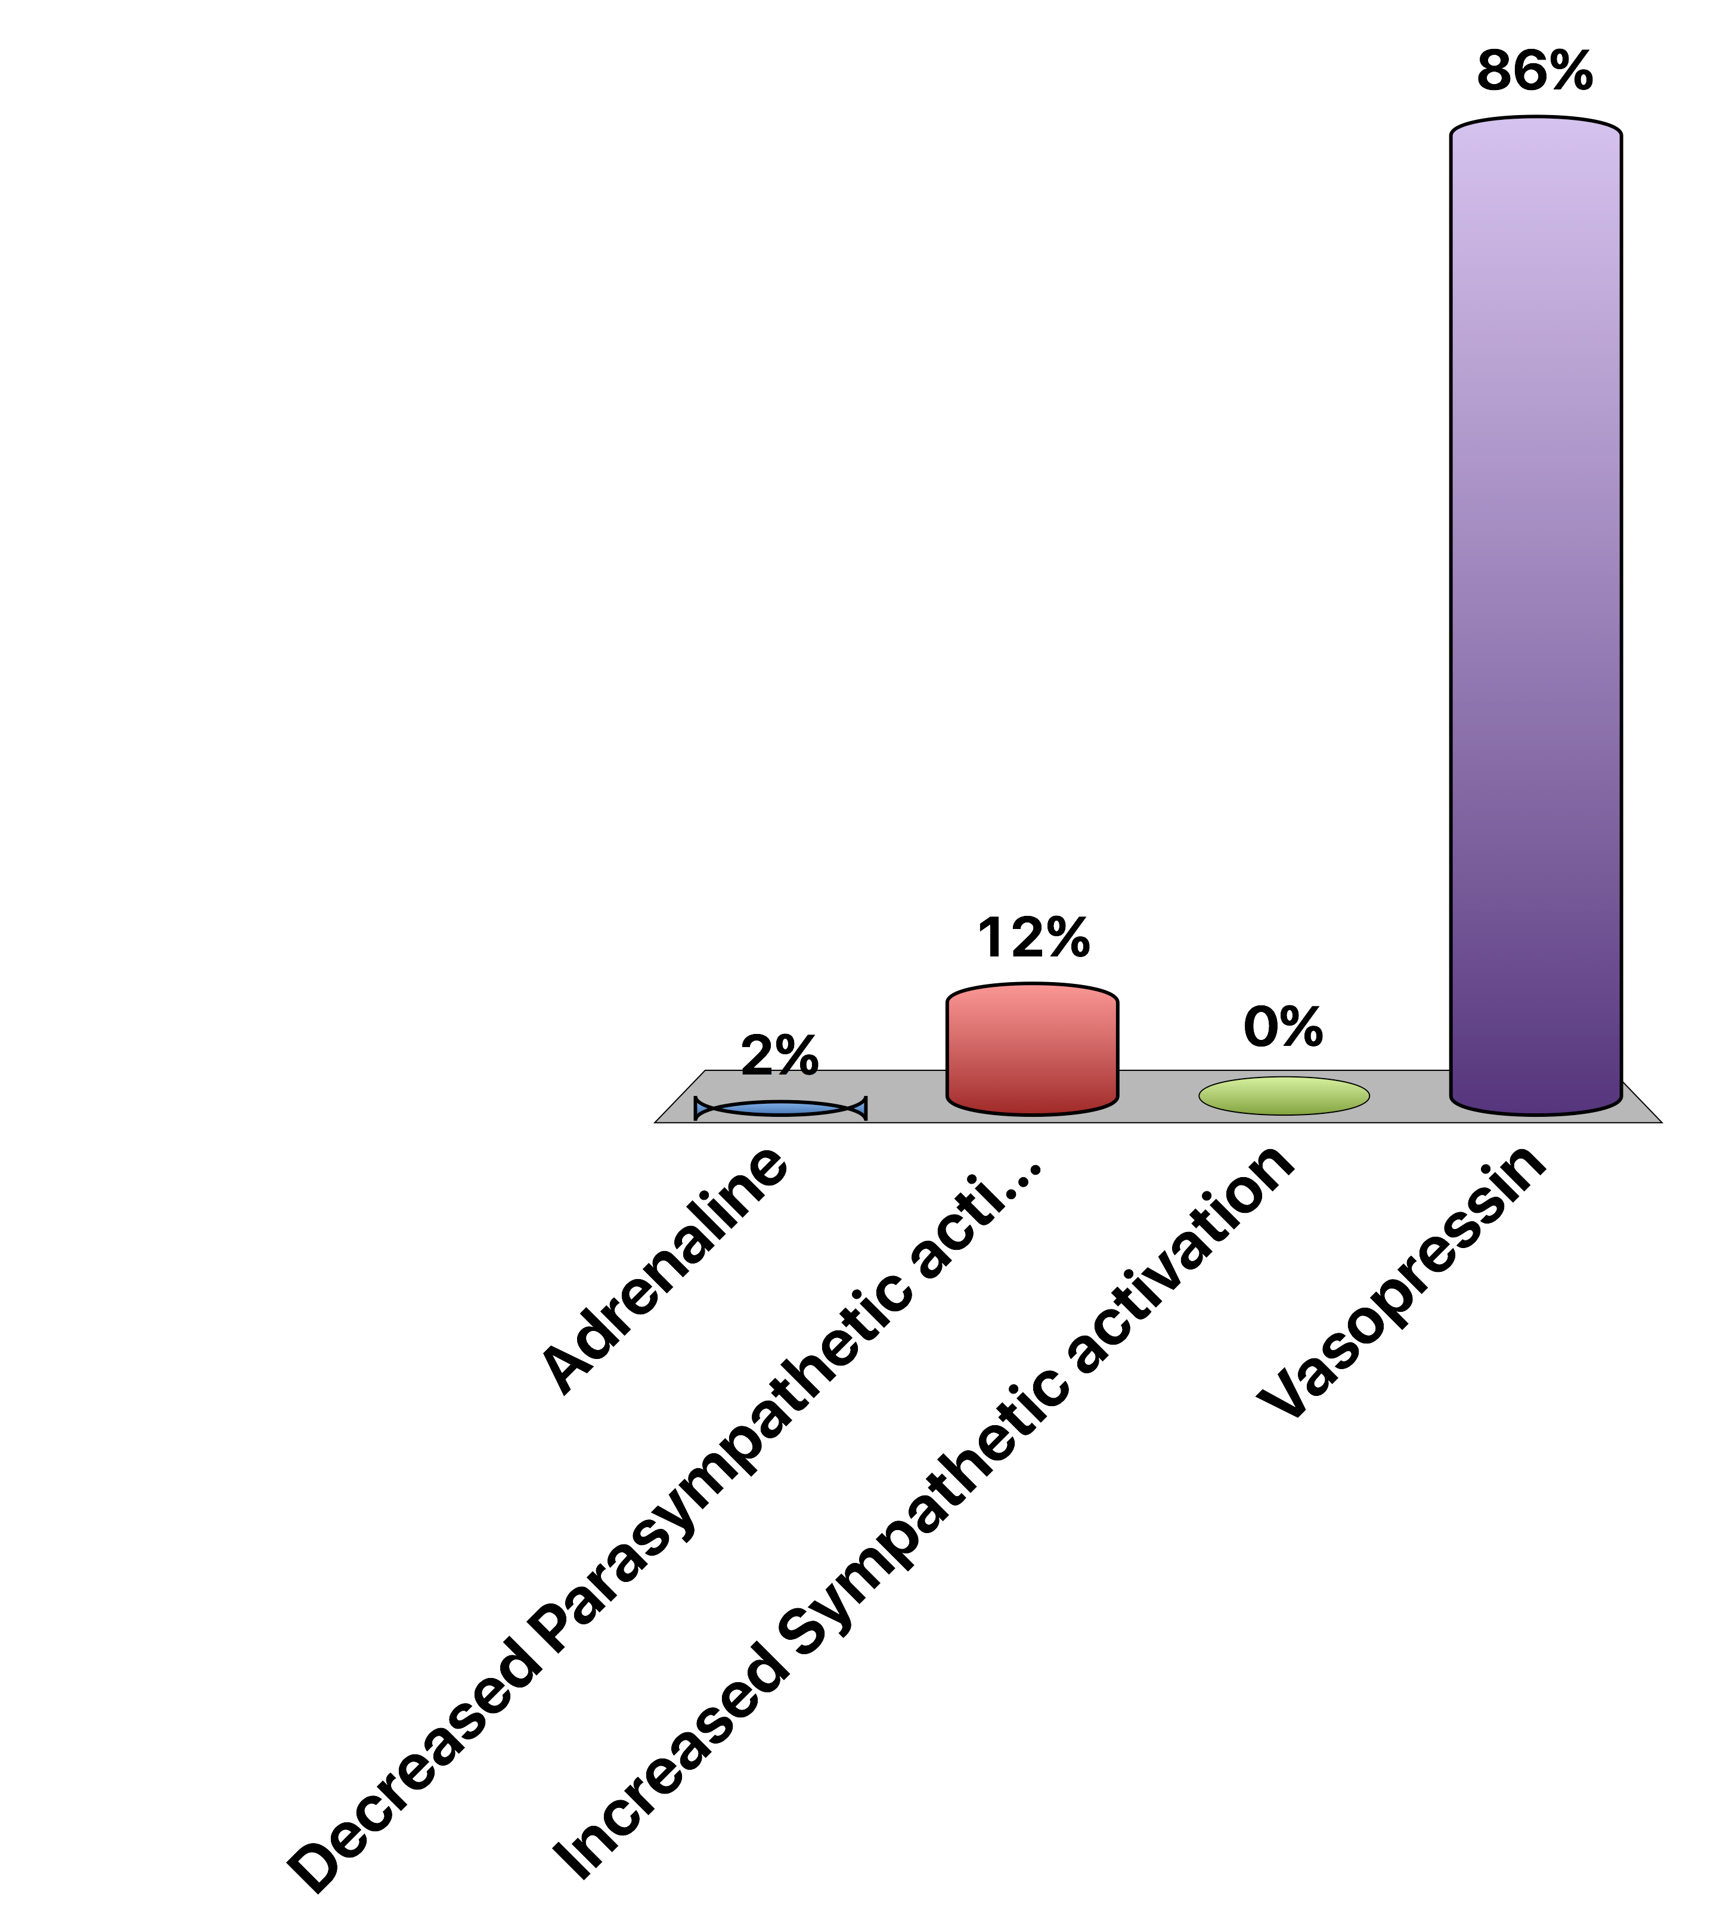
Which does not cause tachycardia
Adrenaline
Decreased Parasympathetic activation
Increased Sympathetic activation
Vasopressin
0

Slide 17
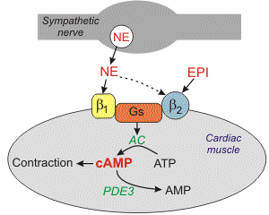
How can we get tachycardia
More adrenaline (adrenal gland)
More noradrenaline (sympathetic)
Less acetylcholine (parasympathetic)
More sensitivity to catecholamines

Slide 18
Swollen Neck

Slide 19
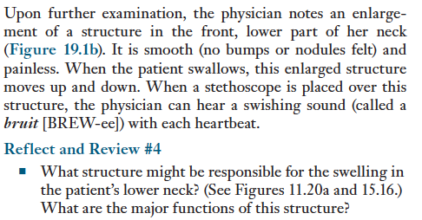
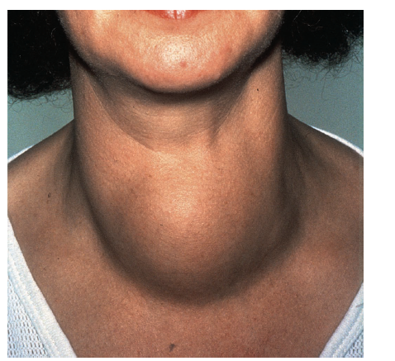
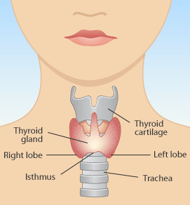
More Physical Evaluation

Slide 20
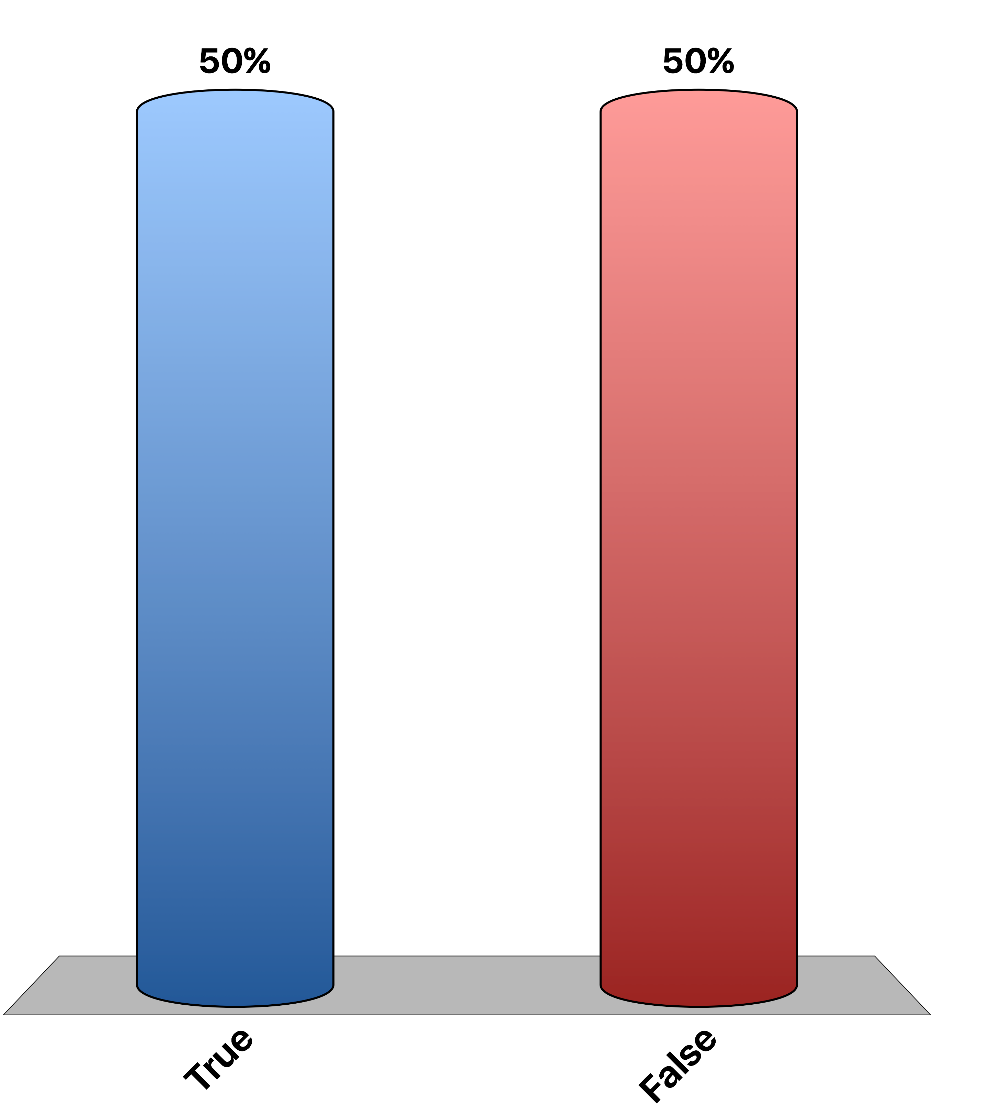
Do you think the enlarged structure could account for increased tendon responses
True
False
30
Notes:
Thyroid hormone causes catecholamine sensitivity

Slide 21
Hormone Levels

Slide 22
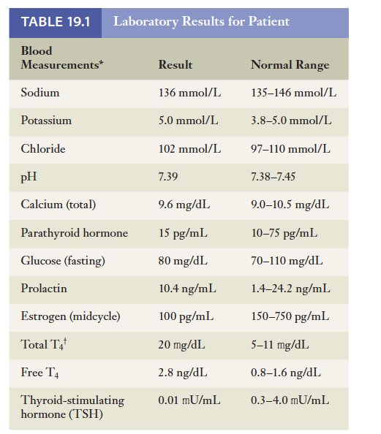
Lab Results
Think about feedback control of hormones who are abnormal, which if any are consistent with the symptoms
Why is glucose obtained from fasted?
is this person diabetic?
Notes:
Why didn’t we measure TRH?

Slide 23
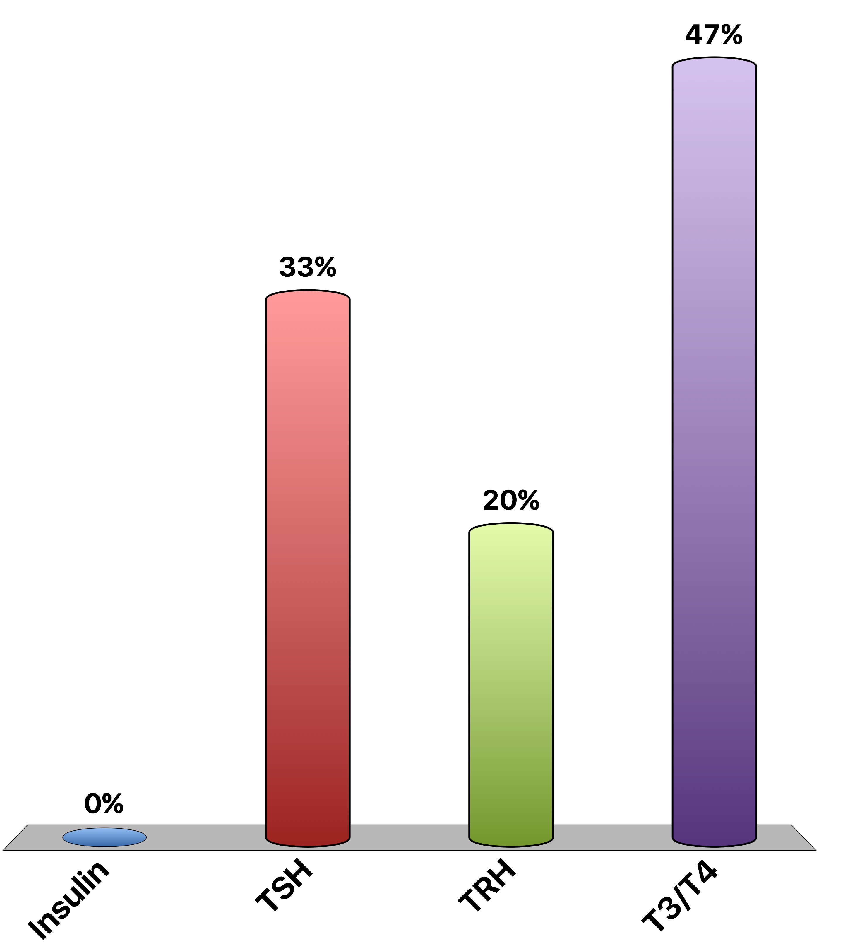
What hormone is the primary problem?
Insulin
TSH
TRH
T3/T4
0
Notes:
T3/T4

Slide 24
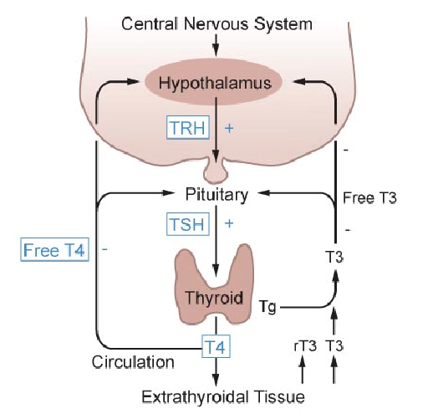
HPT Axis

Slide 25
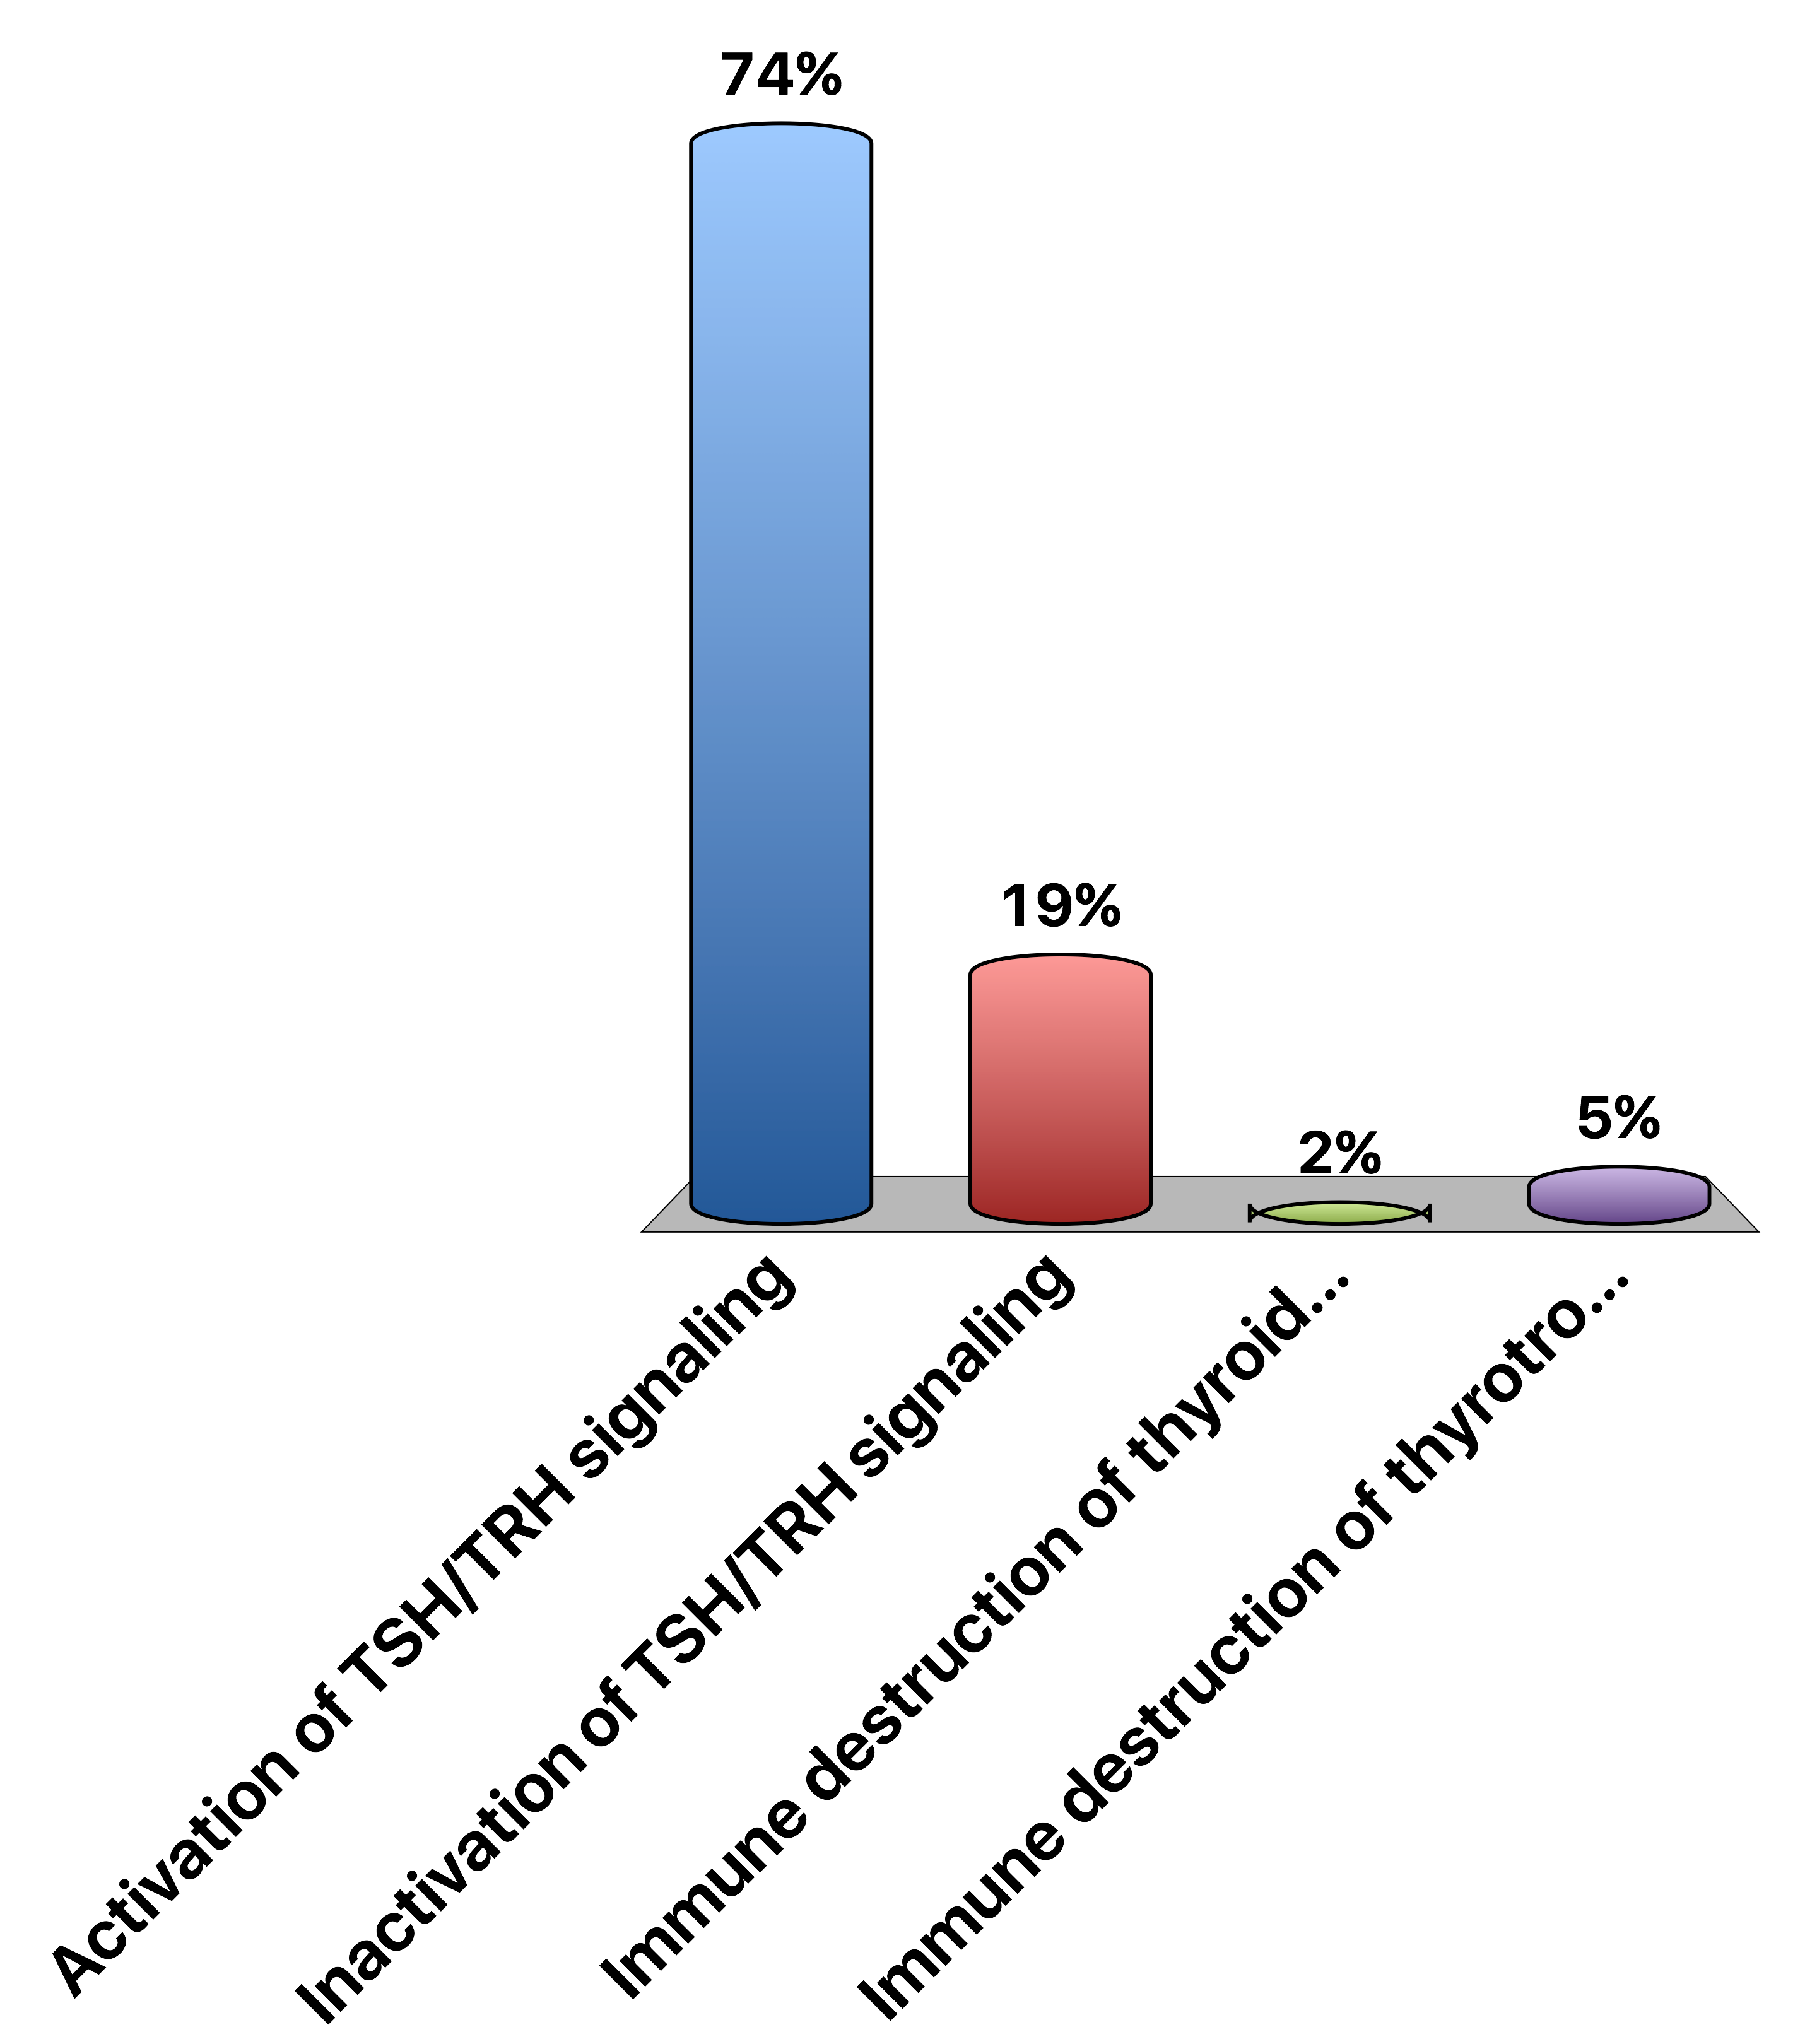
How could you end up with hyperthyroidism?
Activation of TSH/TRH signaling
Inactivation of TSH/TRH signaling
Immune destruction of thyroid gland
Immune destruction of thyrotropes
0

Slide 26
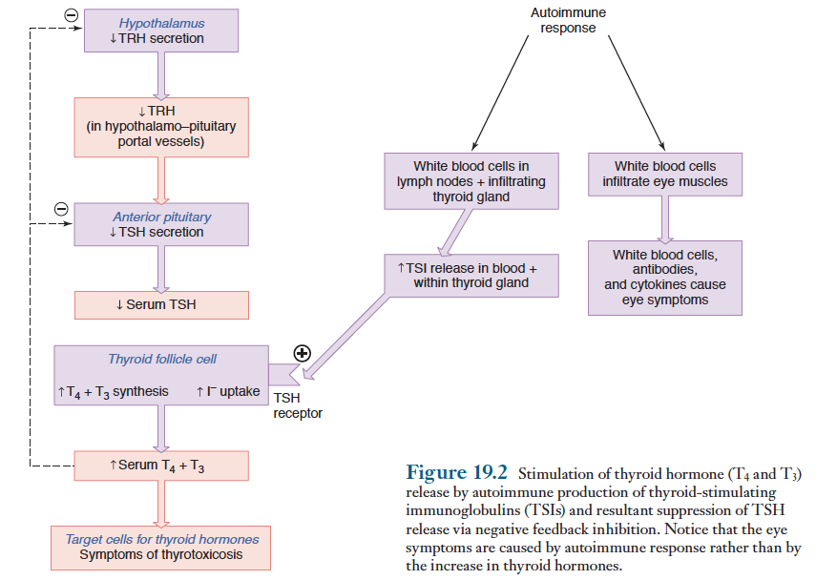
Graves Disease
Notes:
TSI: thyroid stimulating immunoglobulins

Slide 27
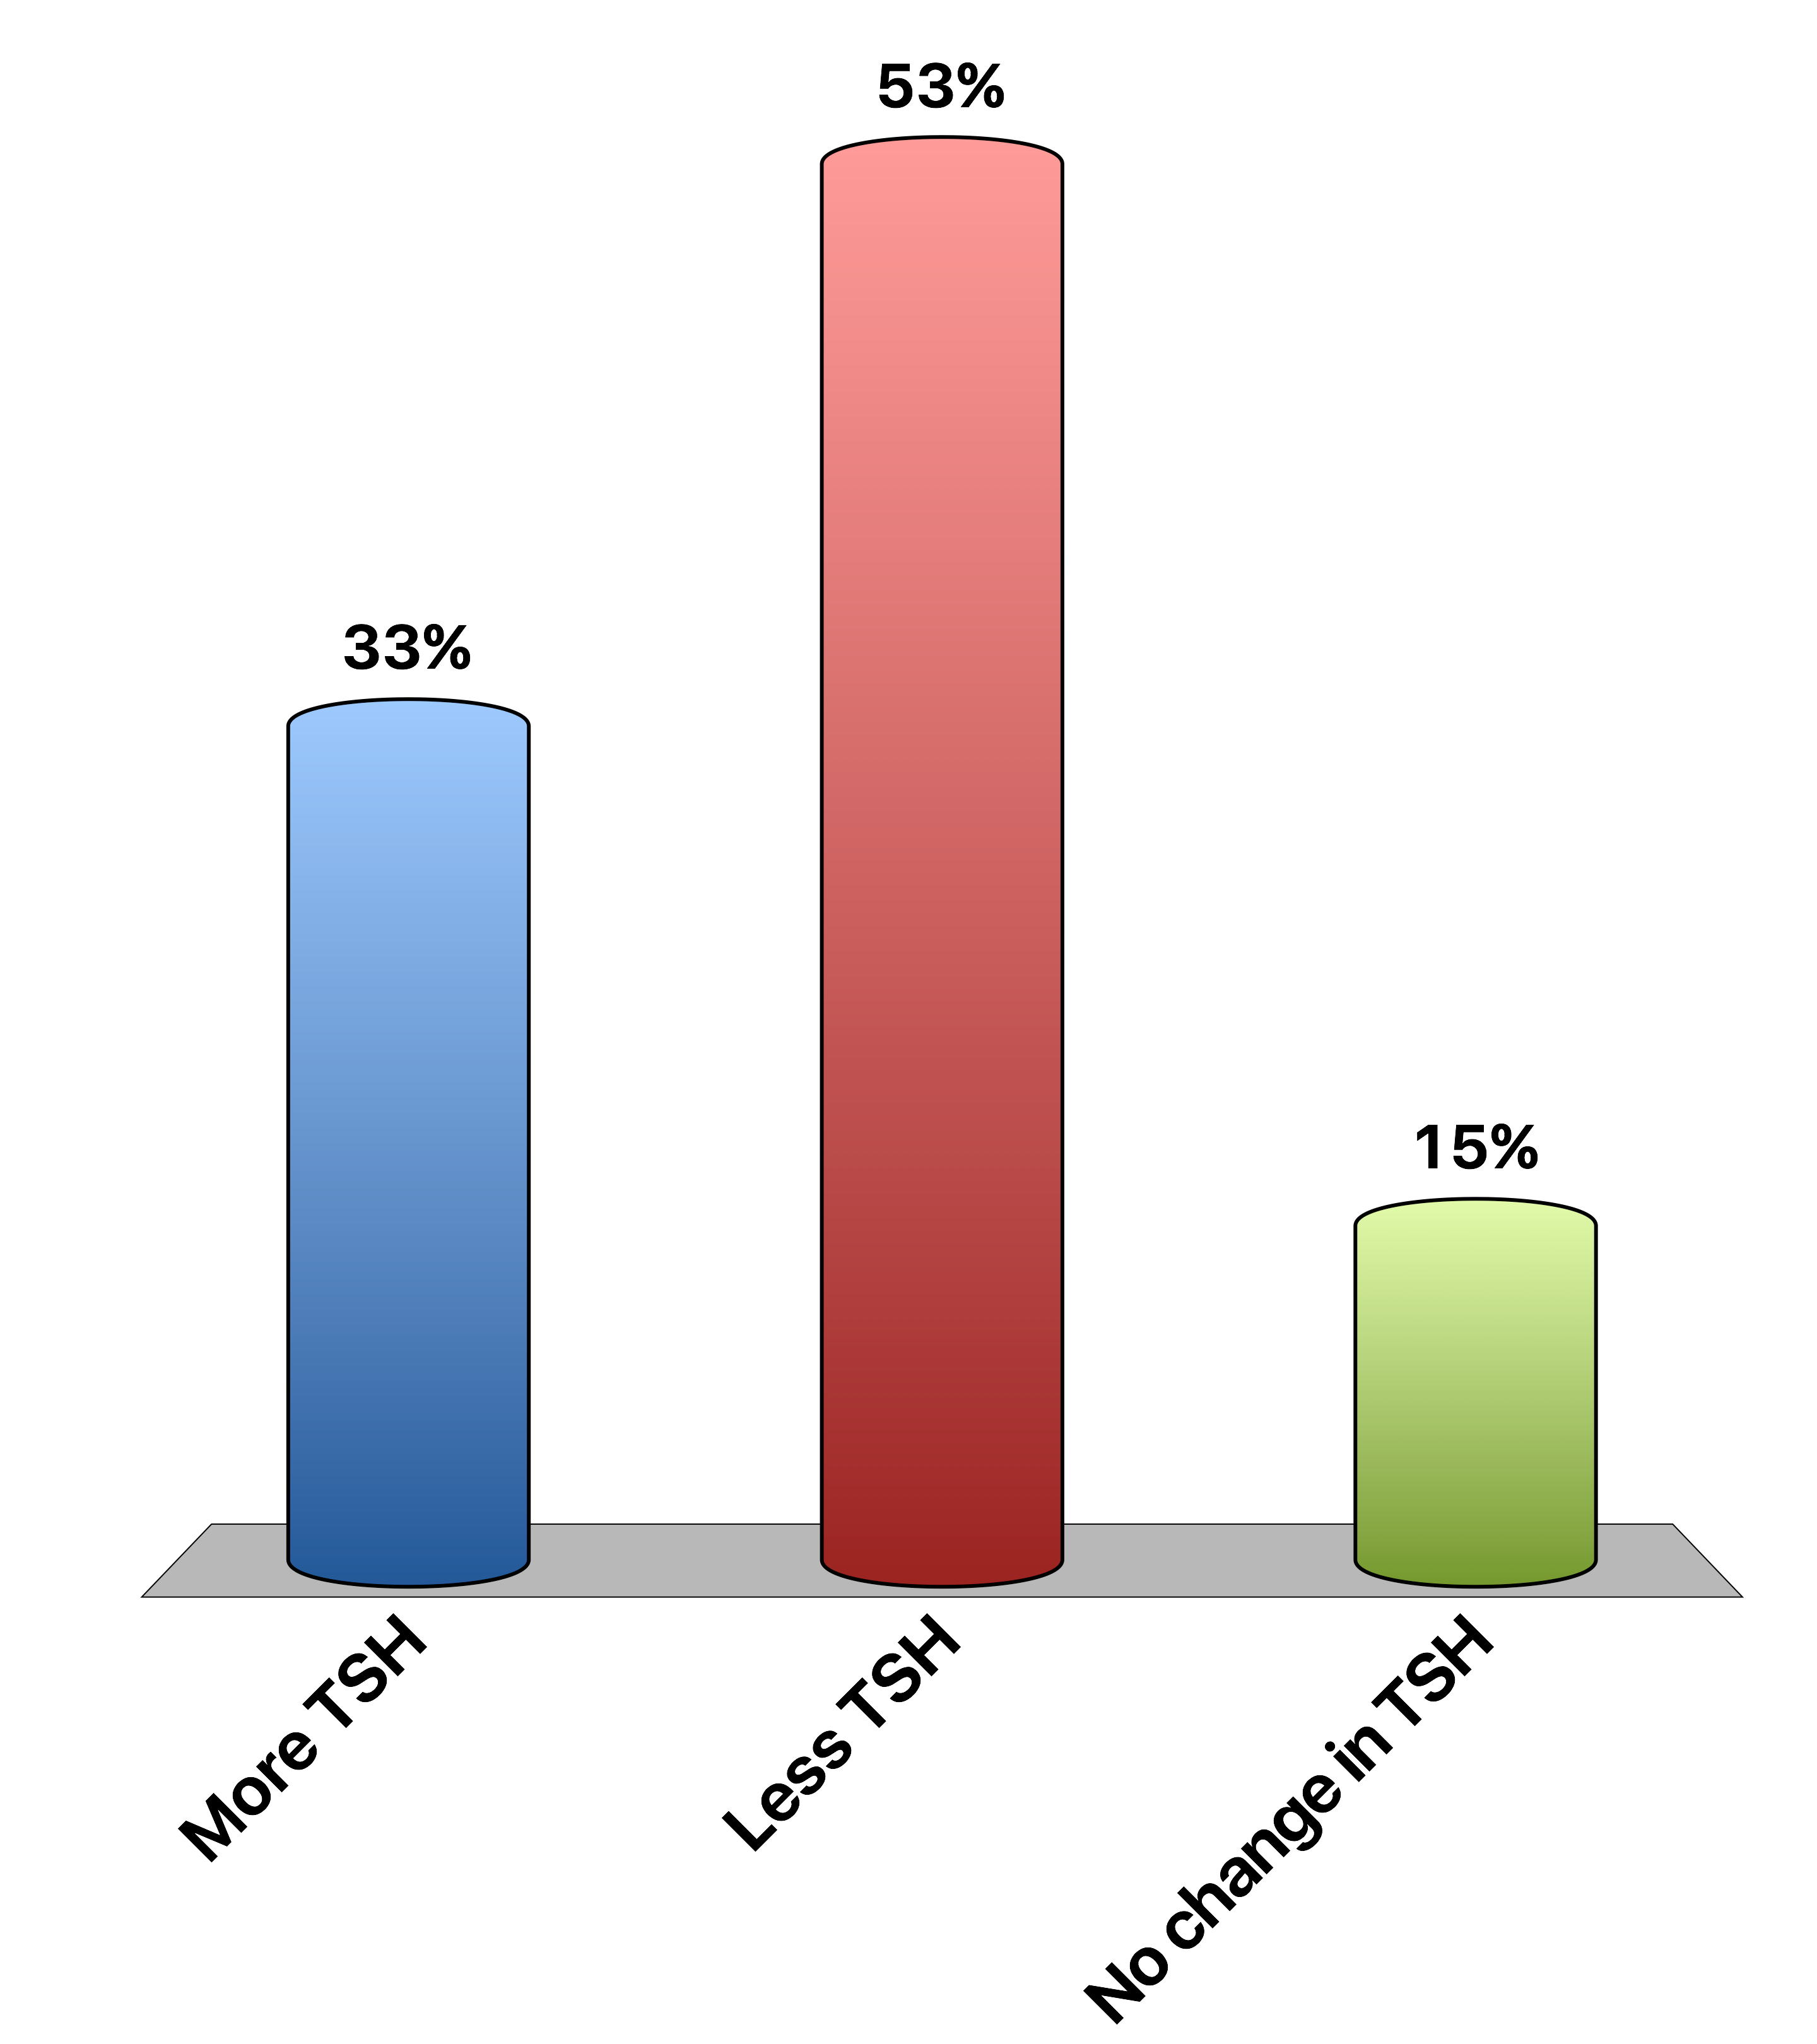
This kind of hyperthyroidism should have what?
More TSH
Less TSH
No change in TSH
Response Counter
15

Slide 28
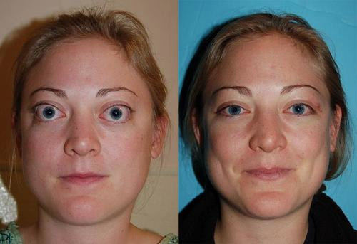
What’s up with the eyes/vision?
Graves disease is associated with bulging eyes
Autoimmune Immune attack of ocular muscles
Swelling and fluid build up causes eyes to bulge

Slide 29
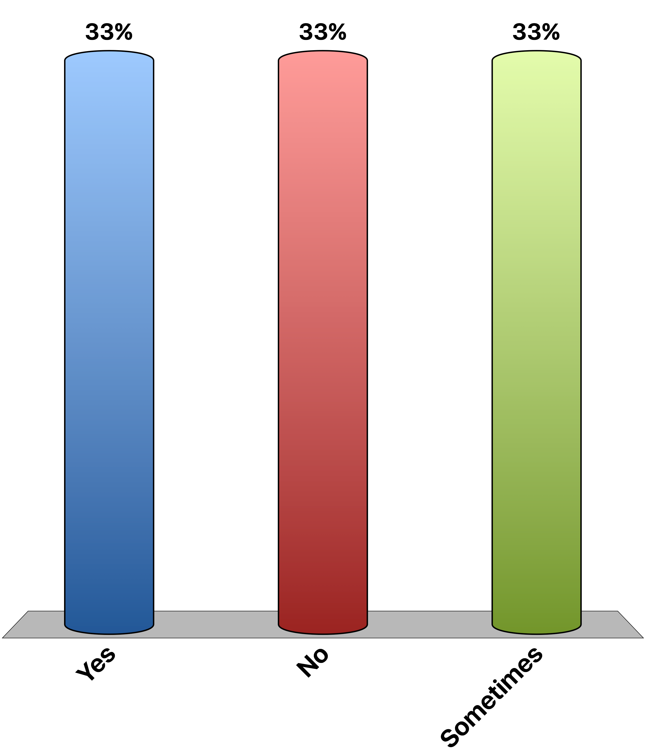
Would you expect lowering of T3/T4 to alleviate the bulging eyes?
Yes
No
Sometimes
Response Counter

Slide 30
Question
Based on the labs, how do we know that this isnt the result of a pituitary adenoma of the thyrotropes?

Slide 31
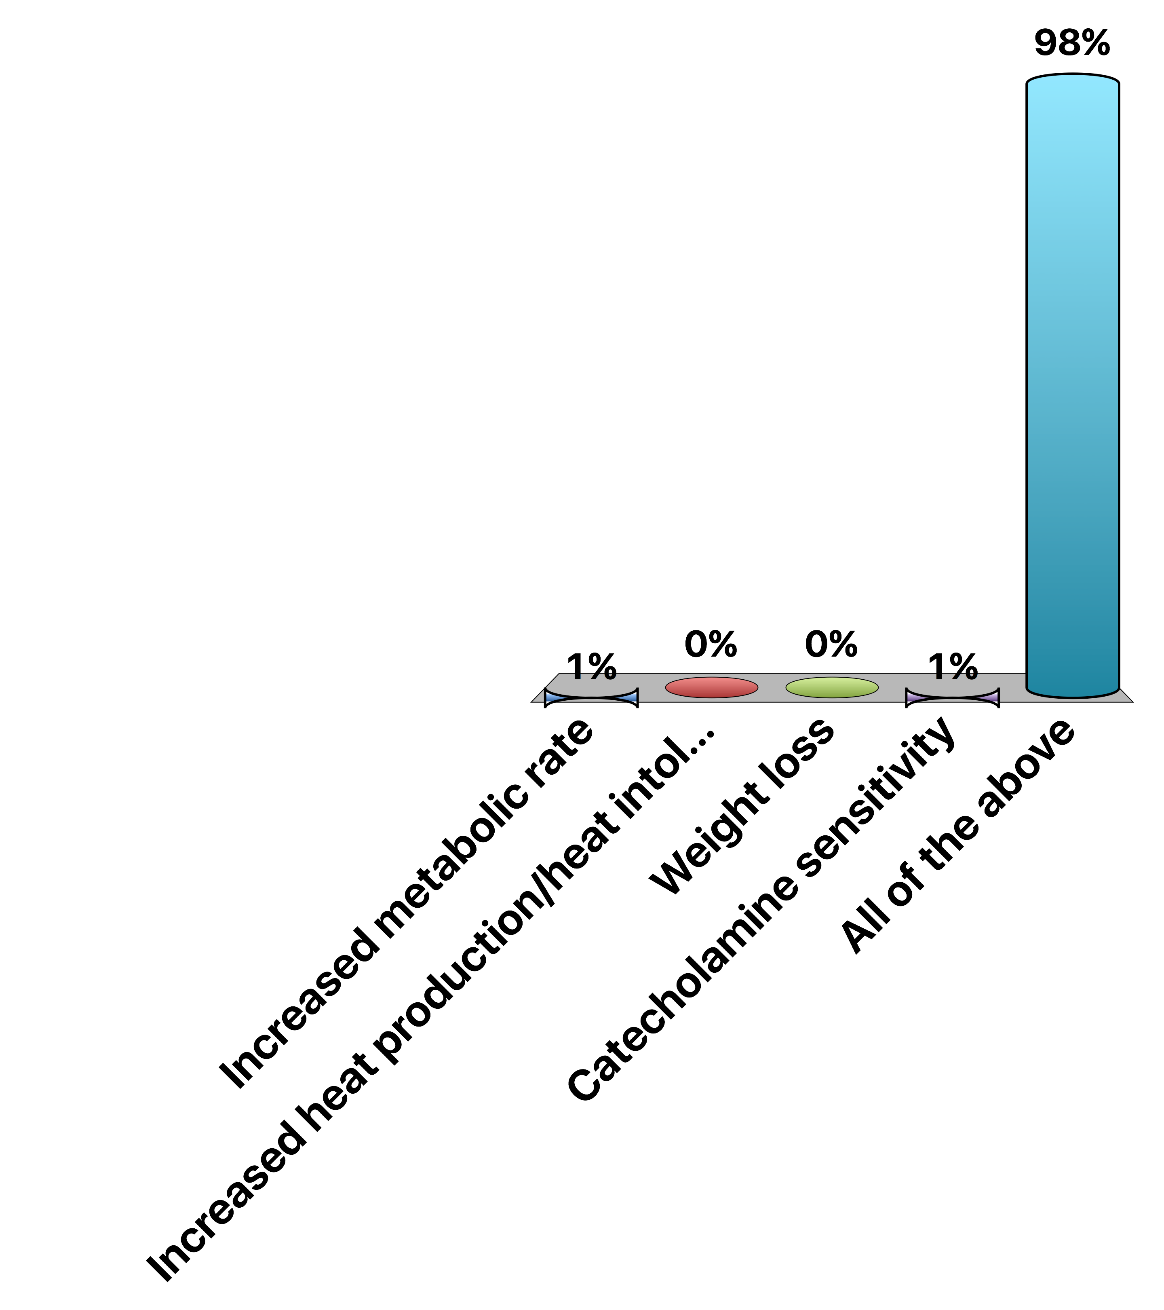
Based on hyperthyroidism we expect…
Increased metabolic rate
Increased heat production/heat intolerance
Weight loss
Catecholamine sensitivity
All of the above
4

Slide 32
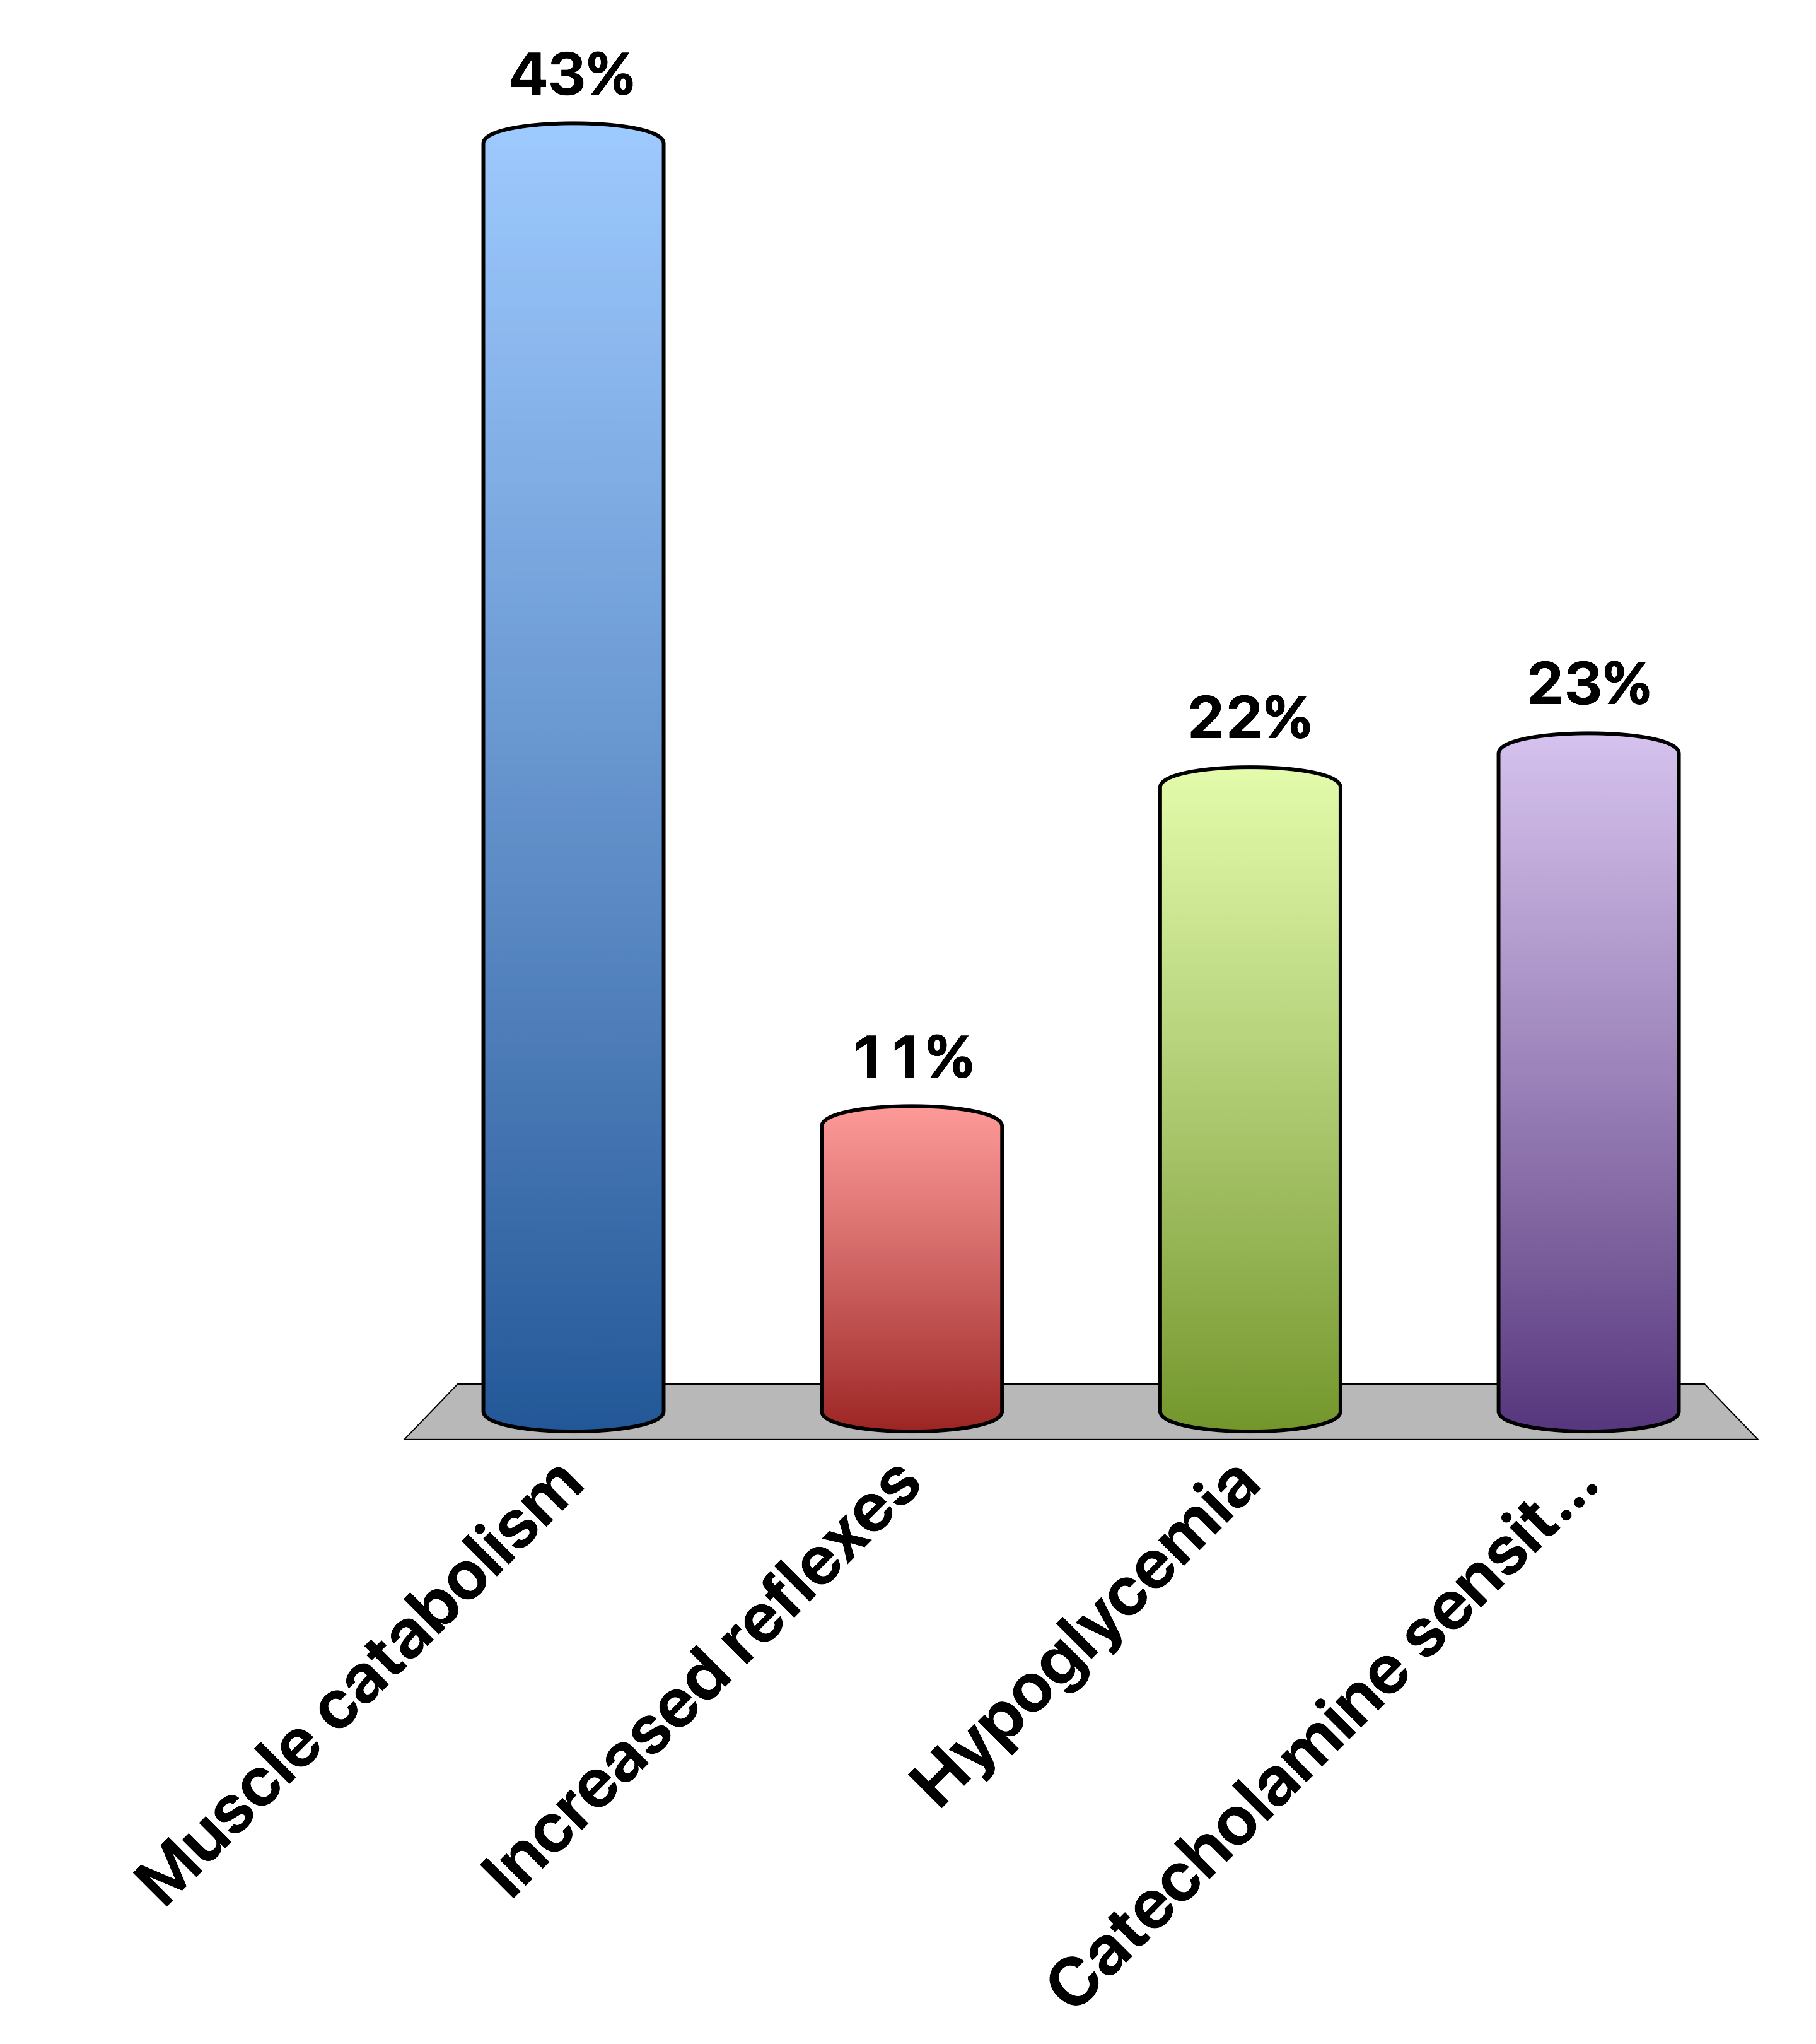
What is the most likely reason for muscle weakness?
Muscle catabolism
Increased reflexes
Hypoglycemia
Catecholamine sensitivity
0

Slide 33
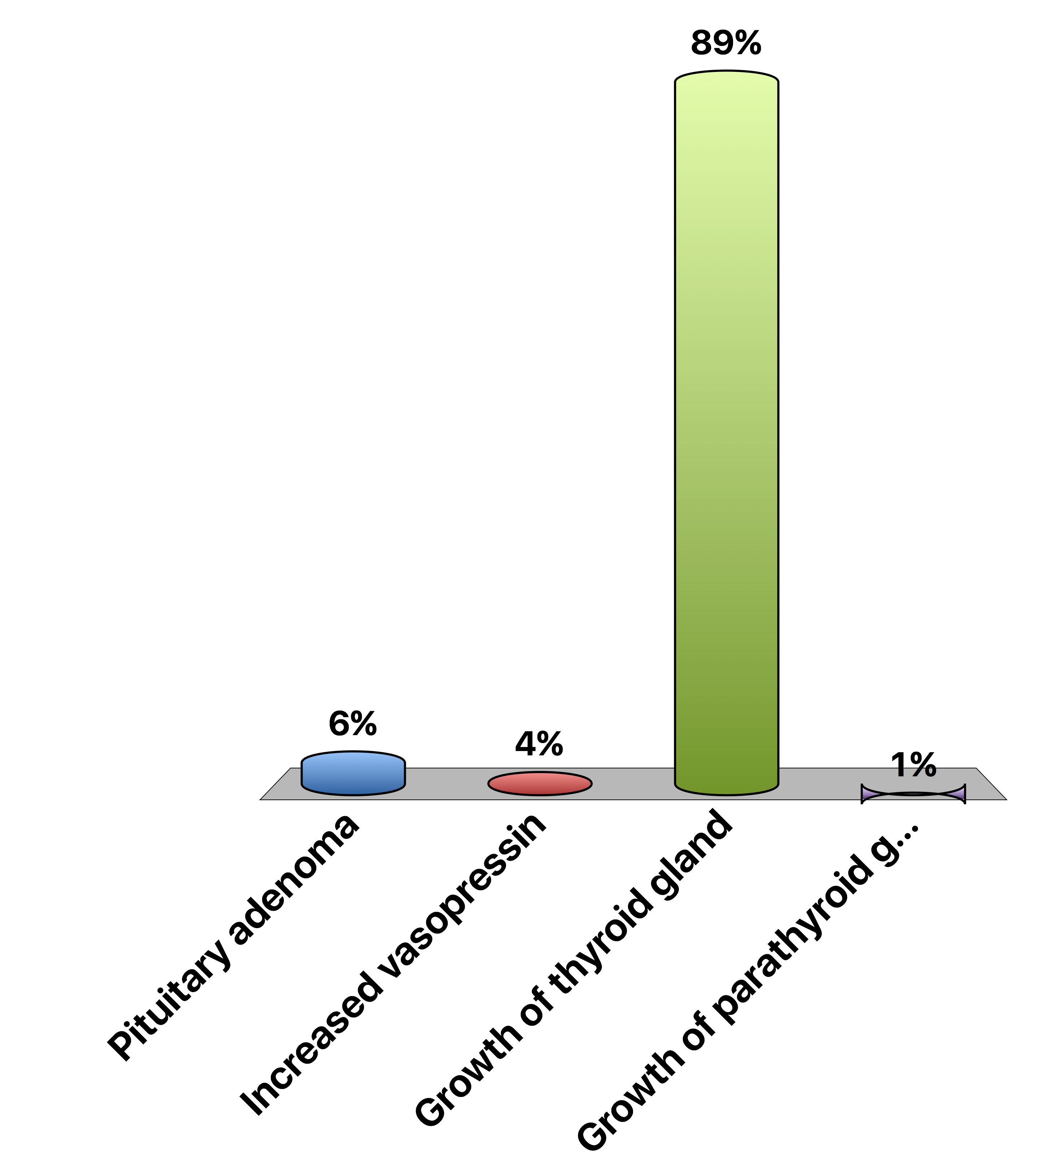
What caused the bruit (swishing sound in the throat)?
Pituitary adenoma
Increased vasopressin
Growth of thyroid gland
Growth of parathyroid gland
0

Slide 34
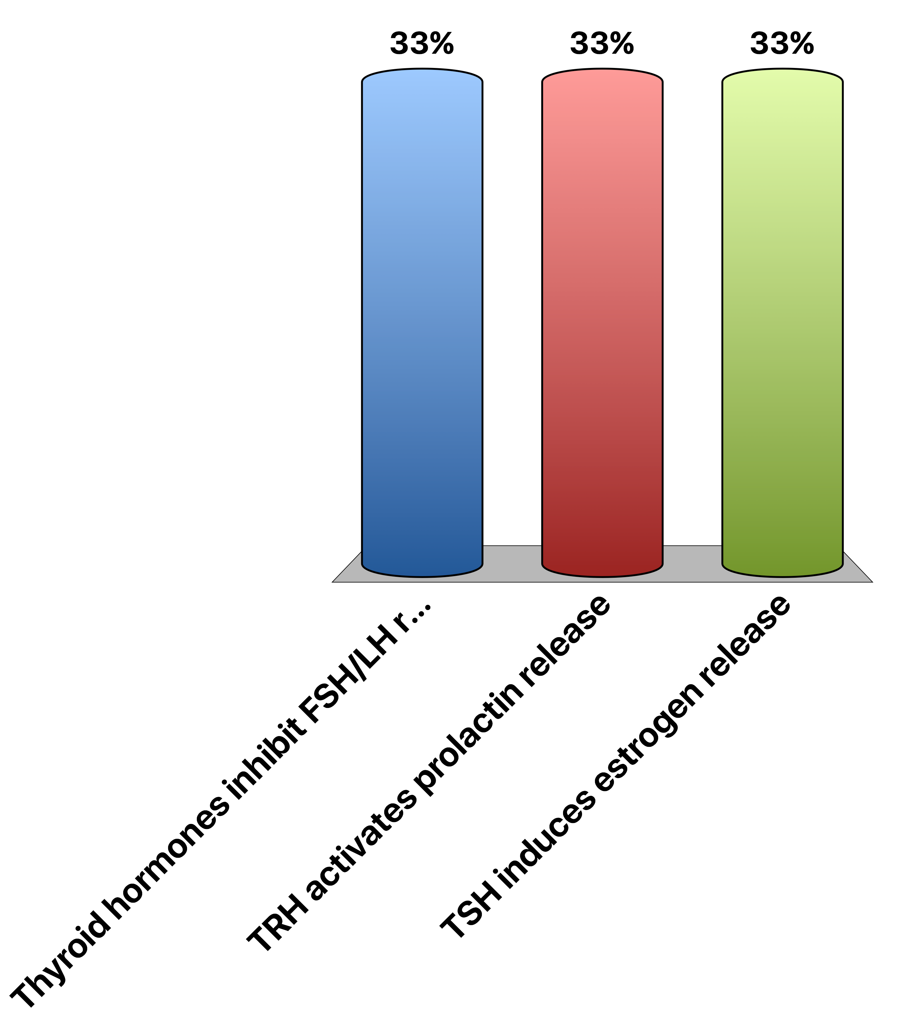
Why was there less menstruation
Thyroid hormones inhibit FSH/LH release
TRH activates prolactin release
TSH induces estrogen release
30

Slide 35
How could you reduce thyroid hormone levels?
Surgically reduce thryoid gland
Block organification of iodine into thyroid hormone (methimazole or propylthiouracil)
Treatment with radioactive iodine

Slide 36
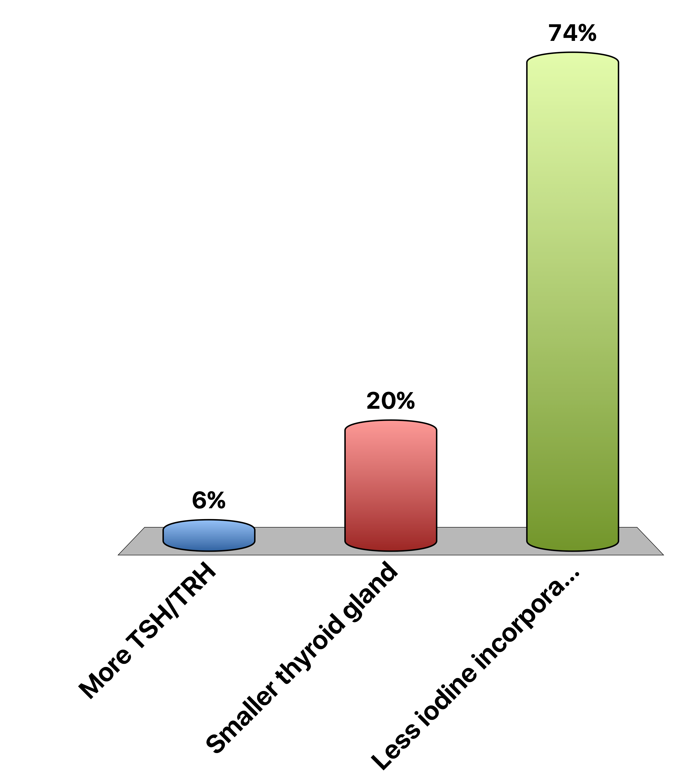
PTU would work via
More TSH/TRH
Smaller thyroid gland
Less iodine incorporation
0

Slide 37
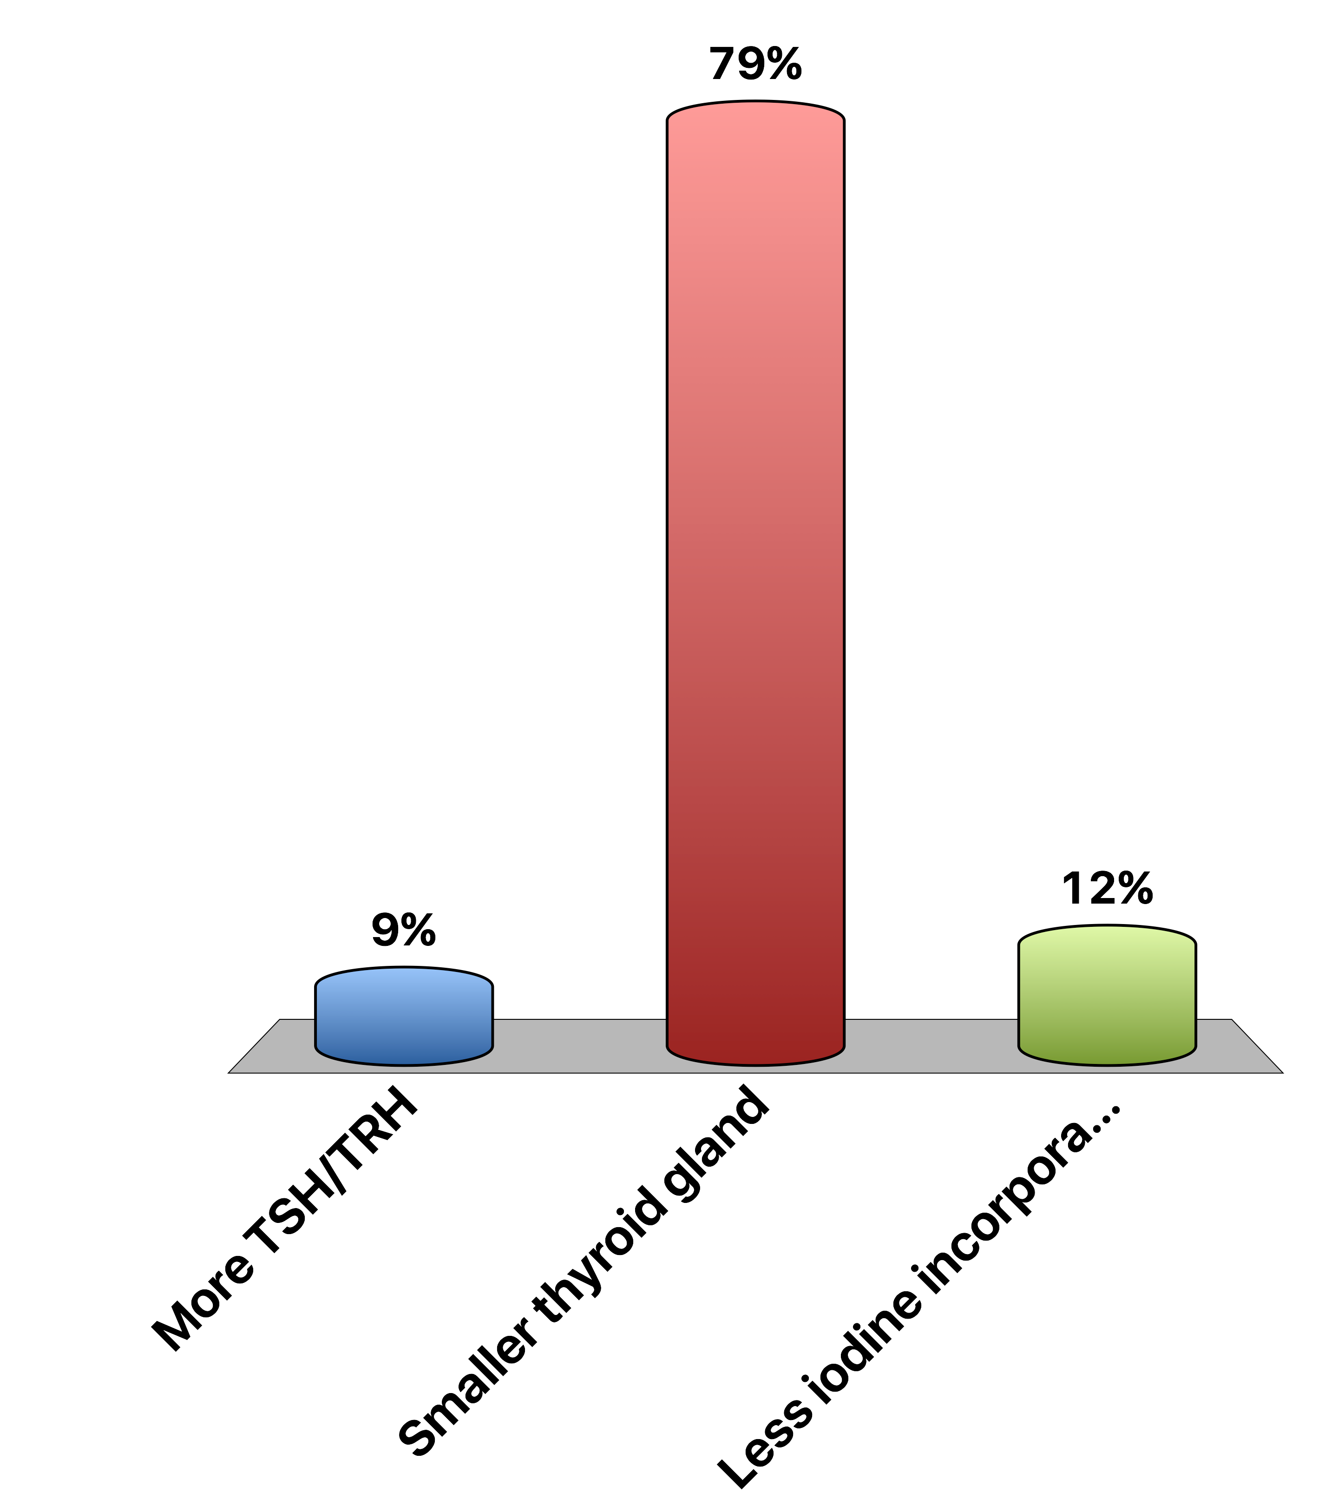
Radioactive iodine would work by
More TSH/TRH
Smaller thyroid gland
Less iodine incorporation
0

Slide 38
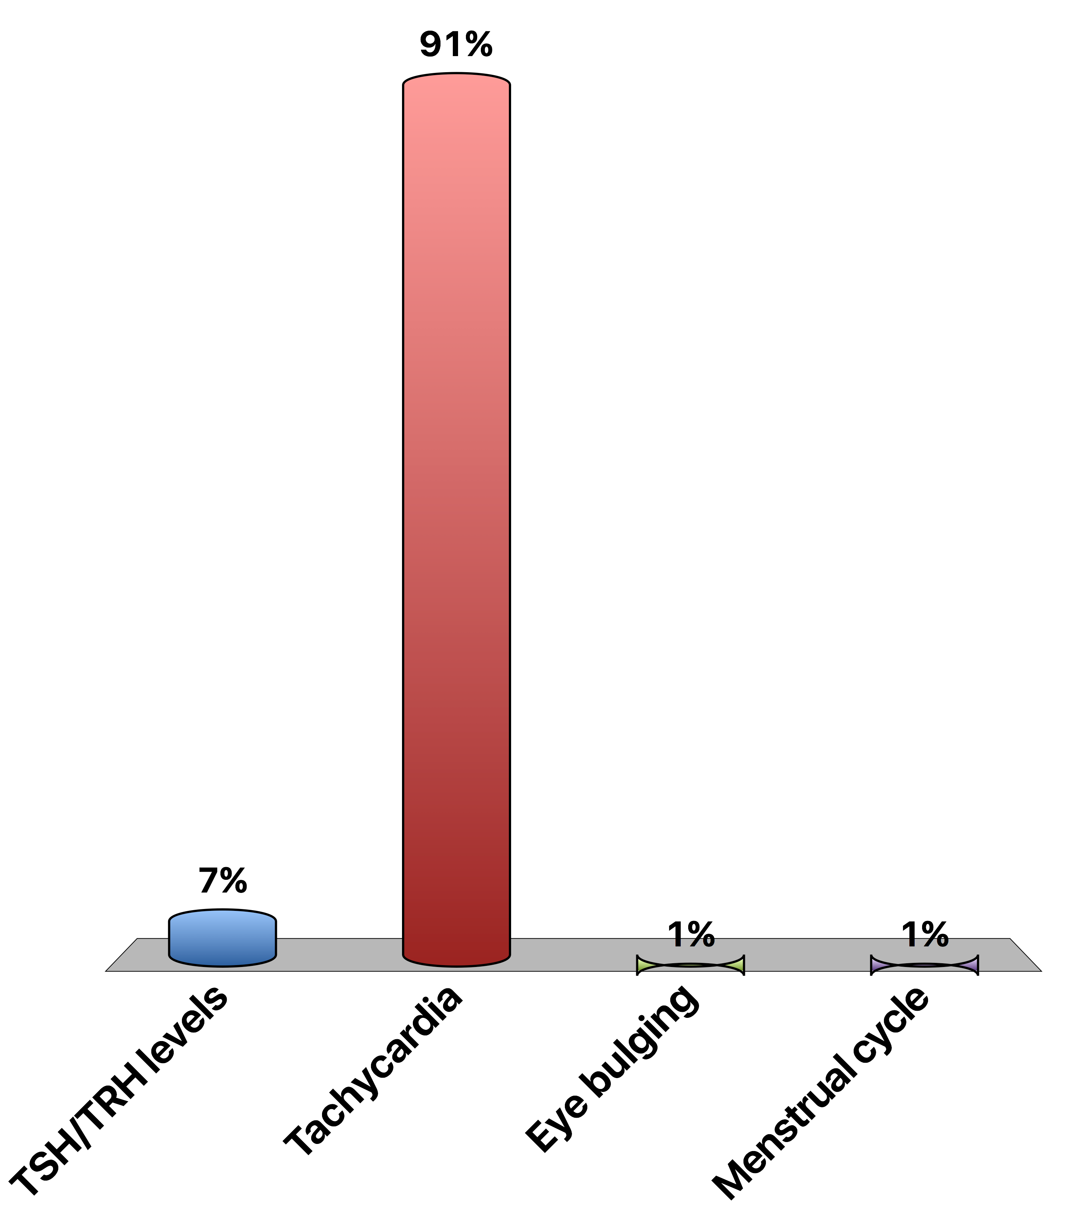
Beta blockers would probably ameliorate which of these?
TSH/TRH levels
Tachycardia
Eye bulging
Menstrual cycle
8
Notes:
Eye bulging due to inflammation

Slide 39
Good luck on the midterm!

